Slide 1

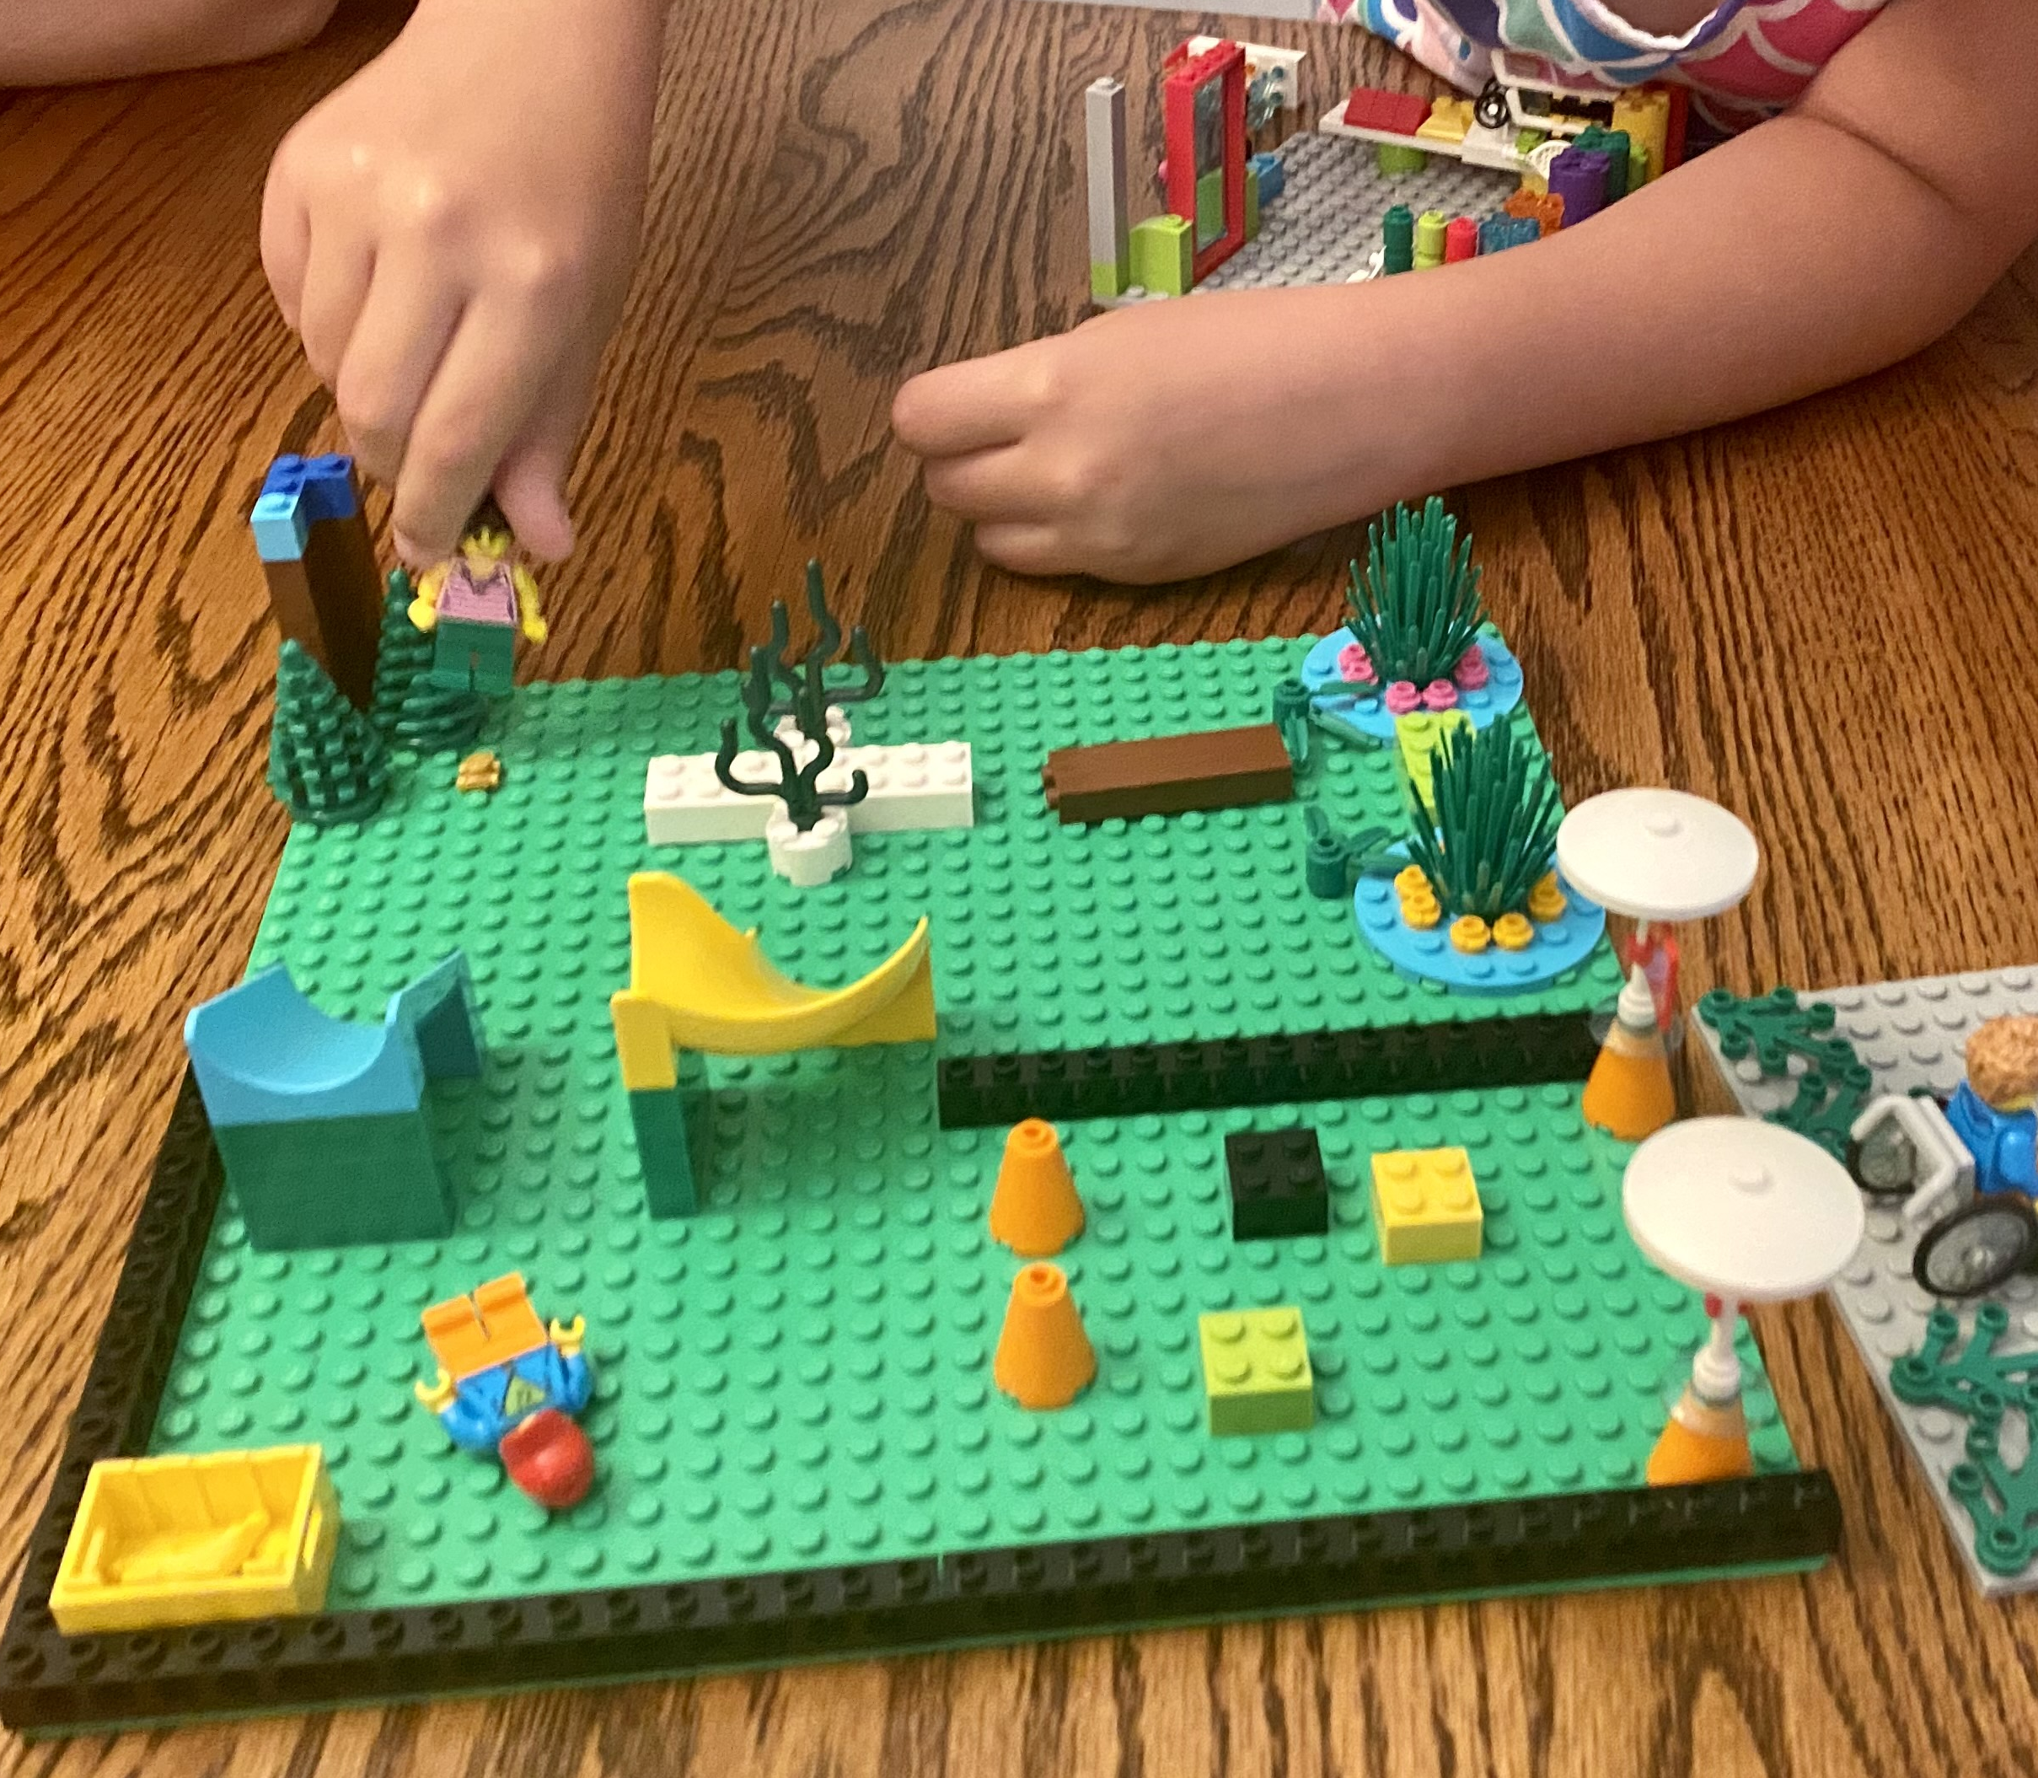
SESSIONS 8 & 9
Build a Team Model

Slide 2
Guiding Questions
What do you think is the most important part of your team model?
How will our team model show the transportation journey of cargo?
Outcomes
The team will draw their team model design and label its required parts.
The team will create their team model that shows the journey of cargo to their destinations.
What are the strengths and the weaknesses of your design?
How can you motorize part of your team model?
Notes:
Each session has Guiding Questions that can be shared to frame the session.​
Session Tips
The team will need their assembled Explore model and mat.
Each team member could build a part of the team model using a baseplate.
The team model can use extra LEGO® bricks, minifigures, baseplates, and other LEGO elements. You may NOT use glue, paint, or art supplies.
The team model should be able to fit on a table and be easily transportable.
The team will apply coding concepts throughout the sessions to create their programs.
The team could reuse the code from Session 5, or they could motorize and code a brand-new part in their model.

Slide 3


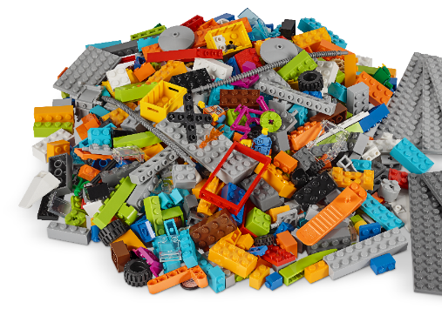
Introduction – Teamwork Build
Session 8
Examples of Teamwork
Ask the students to provide examples of Teamwork and record them here
Example of Teamwork
Example of Teamwork
We found we were stronger when we worked together.
Notes:
***Skip this slide during session 9***
Introduction
Teamwork and Fun Builds
(10 minutes)
Have the team provide examples of how they have used teamwork (Session 8) and fun (Session 9) throughout the sessions.
Have the team create a build from the prototyping pieces representing this Core Value or examples of the team using teamwork and fun.

Slide 4

Introduction – Fun Build
Session 9
Examples of Fun
Ask the students to provide examples of Fun and record them here
Example of Fun
Example of Fun
We enjoyed and celebrated what we did!
Notes:
***Skip this slide during session 8***
Introduction
Teamwork and Fun Builds
(10 minutes)
Have the team provide examples of how they have used teamwork (Session 8) and fun (Session 9) throughout the sessions.
Have the team create a build from the prototyping pieces representing this Core Value or examples of the team using teamwork and fun.

Slide 5

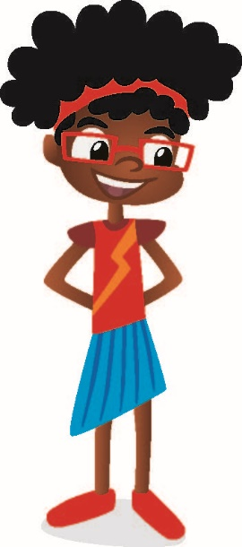


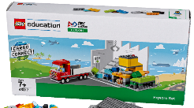
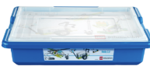
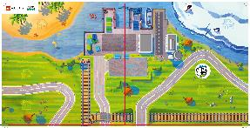
Tasks
You need…
Can you explain
how you improved
the transportation
of the products?
Can you show
the entire journey
of products from
your community
getting to their
destinations?
Notes:
Tasks (80 minutes)
Think about ways to answer the questions.
Brainstorm ideas for each question.
Explore the list of required parts on the next page.
Draw your team model design and label the required parts.
Make a plan! Create your team model together.

Slide 6
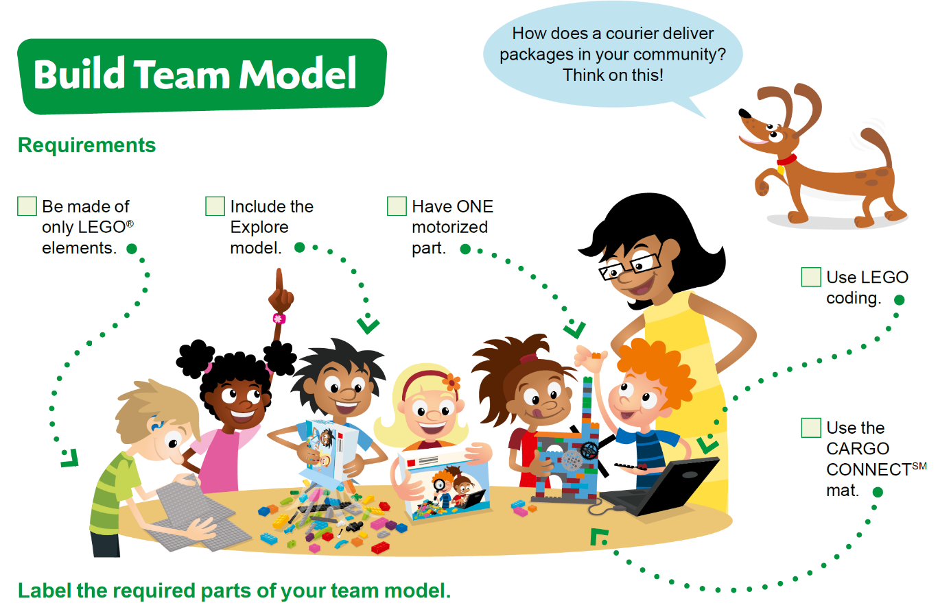
Tasks
Notes:
Tasks (80 minutes)
Think about ways to answer the questions.
Brainstorm ideas for each question.
Explore the list of required parts on the next page.
Draw your team model design and label the required parts.
Make a plan! Create your team model together.

Slide 7
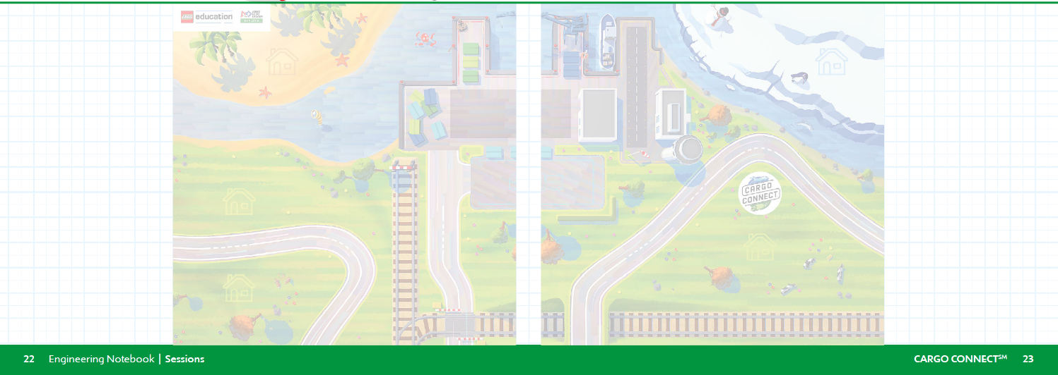
Tasks
Use these two pages to draw your team model design:
Label the required parts of your team model.
Notes:
Tasks (80 minutes)
Think about ways to answer the questions.
Brainstorm ideas for each question.
Explore the list of required parts on the next page.
Draw your team model design and label the required parts.
Make a plan! Create your team model together.

Slide 8
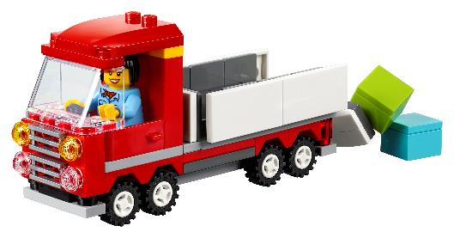
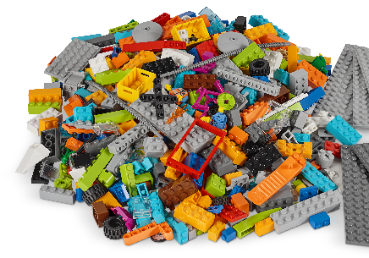
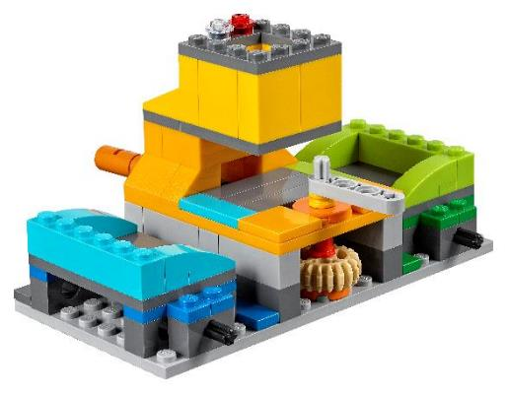

Tasks
Make a plan! Create your team model together.
Notes:
Tasks (80 minutes)
Think about ways to answer the questions.
Brainstorm ideas for each question.
Explore the list of required parts on the next page.
Draw your team model design and label the required parts.
Make a plan! Create your team model together.

Slide 9
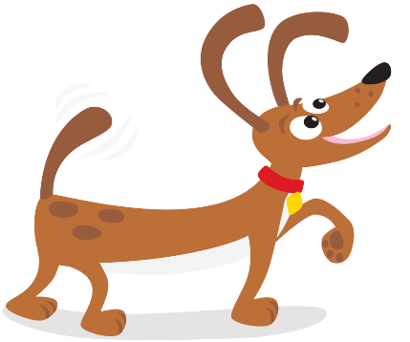
Share
Share what you did in the session.
Explain the program and how it motorizes the sorting center.
Review the list of required parts and identify them on the team model.
Demonstrate how the team model works.
Notes:
Share (10 minutes)
Have the team:
Share what they did in the session.
Explain the program and how it motorizes the sorting center.
Review the list of required parts and identify them on the team model.
Demonstrate how the team model works.

Slide 10

Optional Video:
You may wish to embed a relevant, age-appropriate video for your students here. See the Notes for an example.
Notes:
Choose a relevant, age-appropriate video for your students to show examples of what they will experience at an event.
Search for “FIRST LEGO League Explore Events” to find example videos.
Here is one example that is a recap of what teams experienced at the 2019 FIRST LEGO League World Festival in Detroit. Examples of team models are shown. https://youtu.be/bDZAltVT9rg

Slide 11
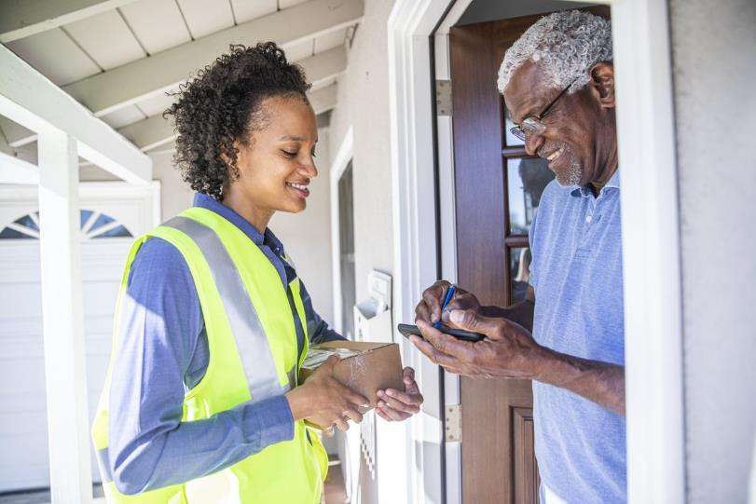
Career Connections
Courier
Role:
Transports and delivers packages to customers.
Notes:
Ask the students to reflect on how they have seen packages transported and a task that a courier might do in their job.

Slide 12
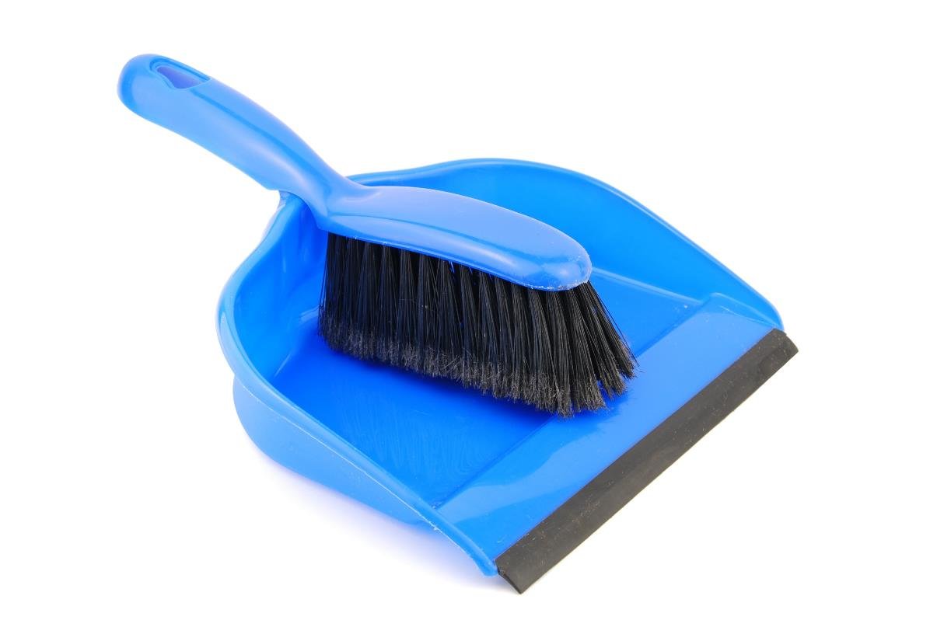
Clean Up
Notes:
You may wish to play a video or song during clean up time Link on GoNoodle: https://family.gonoodle.com/activities/clean-up. Link on YouTube Kids: https://www.youtubekids.com/watch?v=ZJFk87ZsHn0 . Link on Youtube: https://youtu.be/ZJFk87ZsHn0
Cleanup Pointers
• The team model will remain assembled from this point forward until the event.
• Check that any unused pieces from the LEGO® set are returned to it.

Slide 13
FIRST® and the FIRST® logo are registered trademarks of For Inspiration and Recognition of Science and Technology (FIRST). LEGO® is a registered trademark of the LEGO Group. FIRST® LEGO® League and CARGO CONNECTSM are jointly held trademarks of FIRST and the LEGO Group. All other trademarks are the property of their respective owners. ©2021 FIRST and the LEGO Group. All rights reserved.

